Slide 1

Introduction to Nanomaterials and Nanotechnology
DR SWAROOP LAXMI MUDLIAR

Slide 2

BASICS OF NANO CHEMISTRY DEFINITION OF NANO, SCIENTIFIC REVOLUTION-ATOMIC STRUCTURE AND ATOMIC SIZE, EMERGENCE AND CHALLENGES OF NANOSCIENCE AND NANOTECHNOLOGY,

Slide 3
What are nanomaterials?
Nanoscale materials are defined as a set of substances where at least one dimension is less than approximately 100 nanometers. A nanometer is one millionth of a millimeter - approximately 100,000 times smaller than the diameter of a human hair.
They are of interest because at this scale unique optical, magnetic, electrical, and other properties emerge. These emergent properties have the potential for great impacts in electronics, medicine, and other fields.

Slide 4
Where are nanomaterials found?
Some nanomaterials occur naturally, but of particular interest are engineered nanomaterials (EN), which are designed for, and already being used in many commercial products and processes.
They can be found in such things as sunscreens, cosmetics, sporting goods, stain-resistant clothing, tires, electronics, as well as many other everyday items, and are used in medicine for purposes of diagnosis, imaging and drug delivery.

Slide 5
why materials at the nano scale can have different properties?
The two main reasons why materials at the nano scale can have different properties are increased relative surface area and new quantum effects.
Nanomaterials have a much greater surface area to volume ratio than their conventional forms, which can lead to greater chemical reactivity and affect their strength.
Also at the nano scale, quantum effects can become much more important in determining the materials properties and characteristics, leading to novel optical, electrical and magnetic behaviours.

Slide 6
Origin of Nanomaterials
The term nano is originated from the Greek word for dwarf or an abnormally short person.
It is used as a prefix for any unit such as a second or a meter, and it means a billionth (10−9 ) of that unit.
A nanometer (nm) is a billionth of a meter. In a broad term,
Nanomaterials are the materials with sizes of the individual grain or particle in the range of 1–100 nm at least in one dimension.
One nanometer is approximately the length equivalent to 10 hydrogen or 5 silicon atoms aligned in a line

Slide 7
Nano is an SI prefix and comes from the Greek word for dwarf - nanos. One nanometer is 10⁻⁹ meters or about 3 atoms long. At first, it can be hard to comprehend the nanoscale because it is so much smaller than our everyday experience.
The word nano is a scientific prefix that stands for 10⁻⁹ or one-billionth; the word itself comes from the Greek word nanos, meaning dwarf. “Structures, devices, and systems having novel properties and functions due to the arrangement of their atoms on the 1 to 100 nanometer scale.

Slide 8
What is nanomaterial?
A nanomaterial is often characterized by a dimension linked either to the dimension of the salient nanofeatures making up the material or to their organization.
When some interesting property of a material emerges from the organization or pattern of random or well-ordered nanopatterns, the resultant material is referred to as nanostructure or nanostructured material.

Slide 9
Synthesis of Nanomaterials
Some of those methods are top-down and bottom-up approaches.
Top-down includes mechanical alloying, nanolithography, electron-beam lithography, x-ray lithography techniques, soft lithography, and severe plastic deformation.
The bottom-up approach includes synthesis of nanoparticles by physical vapor deposition, chemical vapor deposition, colloidal route, green chemistry route, and sol-gel method, where there is buildup of atoms or molecules layer by layer.
In general, nanoparticles or nanoplatelets or nanotubes are energetically not favorable and therefore their properties have been exploited by embedding them in polymer or metal or ceramic matrices to make them thermodynamically stable nanocomposite

Slide 10
Classification of Nanomaterials
1. 0-D Nanomaterial
They have all three dimensions negligibly small. They are also known as artificial atoms (orquantum dots) because their energy levels are discrete.
Metallic nanoparticles include goldand silver nanoparticles, whereas semiconductor nanoparticles include quantum dots of CdS,CdSe, and CdTe.
Nanoparticles may have shapes such as spherical, cubic, or polygonal withsize in the range of 1–50 nm. The most common example is fullerene, which was identified
Fullerene (C60) is the smallest and the most stable structure owing to high degree of its symmetry. C60 consists of 60 carbon atoms. The C60 molecule looks like a soccer ball (Figure 1.2a) and it is often called a soccer ball molecule. This molecule is composed of 12 pentagons and 20 hexagons whose vertexes contain carbon atoms.
.

Slide 11
Nanomaterials have a much greater surface area to volume ratio than their conventional forms, which can lead to greater chemical reactivity and affect their strength. Also at the nano scale, quantum effects can become much more important in determining the materials properties and characteristics, leading to novel optical, electrical and magnetic behaviours.

Slide 12
Each carbon atom of pentagon or hexagon is shared by three other carbon atoms; hence, total carbon atoms in C60 are = 12 (pentagonal) × 5 carbon atoms × ⅓ + 20 (hexagonal) × 6 carbon atoms × ⅓ = 60.
Solid C60 has face-centered cubic lattice at room temperature and its density is ∼1.69 g/cm3
Molecules are freely rotating due to weak intermolecular interaction. Fullerene is an allotropic modification of carbon. Besides C60, other fullerene molecules are C70, C76, C78, and C84.
C70 molecule consists of 70 carbon atoms. Fullerene molecules are quite stable; however, like
in graphene, each carbon atom has only three neighbors. Therefore, there are free valences,which may be used for functionalization.
It is possible to attach metal atoms or other molecules at the surface. Owing to 0-D structure, fullerene has a minimum surface energy

Slide 13
Classification of Nanomaterials
2. 1- D Nanomaterials:
1-D Nanomaterials :They have two dimensions of particulates in the nanometer scale and the third dimension is significant compared to other two dimensions, that is, they have length of several micrometers (or >100 nm) and diameter of only a few nanometers.
Examples include nanotubes, nanofibers, nanorods, or whiskers of metals or oxides, and carbon nanotubes (CNTs) and carbon nanofibers (CNFs).
These entities have a very high-surface area and aspect ratio, which are useful in nanocomposites. Imogolite is a naturally occurring 1-D silica
One-dimensional (1D) nanofillers are those fillers that have one of their dimensions less than 100 nm [ They are usually in the form of sheets of one to a few nanometers thick to hundreds and thousands of nanometers long. Montmorillonite clay and nanographene platelets are common examples of 1D nanofillers.

Slide 14
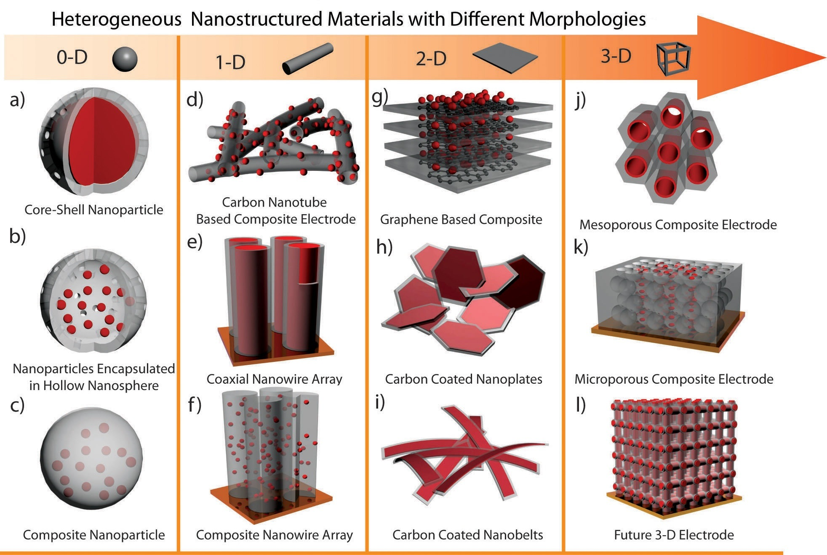

Slide 15
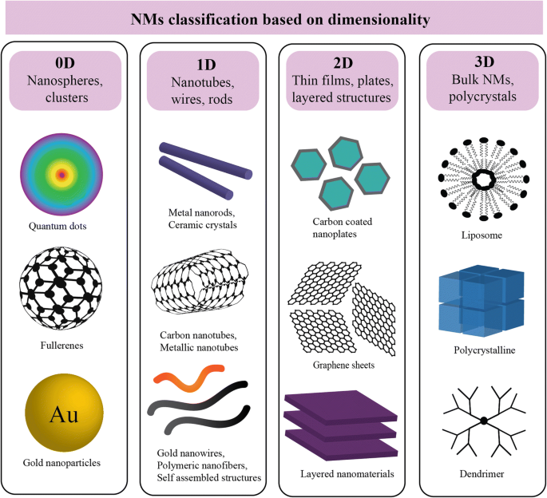

Slide 16
2-D Nanomaterials
2-D Nanomaterials
They have one dimension in the nanometer scale and other two dimensions are significantly large compared to third dimension (i.e., thickness).
Examples are graphene, nanolayers, nanoclays, nanosheets, nanofilms, platelet-like structure, nanoflakes, or nanoplatelets and silicate nanoplatelets.
The area of the nanofilms or coating is of the order of several square centimeters, but the thickness is in the range of 1–100 nm.
Montmorillonite (MMT) clay is a hydrous alumina silicate mineral whose lamellae are constructed from an octahedral alumina sheet sandwiched between two tetrahedral silicate sheets (2:1 layer silicate).
In a natural state, the clay platelets are ∼1 nm in thickness and other dimensions (i.e., length and width) can be of the order of 150 nm to 2 µm.
In materials science the term single-layer materials or 2D materials refers to crystalline solids consisting of a single layer of atoms. ... 2D materials can generally be categorised as either 2D allotropes of various elements or as compounds (consisting of two or more covalently bonding elements)

Slide 17
3-D Nanomaterials
3.3-D Nanomaterials
All dimensions of these materials are outside the nanometer range.
They are generally referred to as equiaxed nanoparticles or nanocrystals.
The best example is the nanostructured bulk, which consists of individual blocks with the size in the range of 1–100 nm.
3-D nanomaterials are also known as bulk nanomaterials, which are not confined to the nanoscale in any dimension. These materials have all three dimensions >100 nm.
These materials possess a nanocrystalline structure or features at the nanoscale, that is, bulk nanomaterials consist of a multiple arrangement of nanosized crystals typically in different orientations.
In other words, 3-D nanomaterials can contain dispersions of nanoparticles, nanowires, nanotubes, or multinanolayers, etc. in the matrix

Slide 18
In the last few decades, the technologies for the fabrication of integrated circuits have
made the smallest structure (i.e., <100 nm) elements of microelectronic chip devices
by mass production. The gate length of solid-state transistors has reached in the range
of few tens of nanometers

Slide 19
Nanotechnology in the Twenty-First Century
Nowadays, microprocessors have circuit features with size of ∼14 nm across, smaller than most of the viruses. In the early 2000s, the features shrunk below ∼90 nm; however, this miniaturization is facing problem of heat dissipation which has restricted the speed of device.
Thus, due to multifunctional miniaturization, cell phones are becoming tinier, laptops are getting lighter, and a thin strand of optical fiber is replacing thick bundles of copper telephone wire. For example, a 100 times decrease in linear size scale translates into 106 by volume, that is, 1 million times more circuitry could be stuffed into the same volume.

Slide 20
Scientists have exploited the bottom-up nanotechnology of the nature and replicated a large number of examples including self-cleaning glasses, nano fabrics, nanomotors, nano brushes, nano paints, and hundreds of more developments by assembling and manipulating atoms, molecules, and solids.
It has been well studied that as the diameter of metallic nanowires shrinks, the resistivity and failure current density increase due to increased scattering of the conduction electrons by the surface of the nanowires, internal grain boundaries (GBs), and surface-to-volume ratio.

Slide 21
Moreover, due to the surface plasmon resonance (SPR) effect, the extinction peaks of gold nanowire arrays possessed a blueshift with decreasing diameter of the nanowires

Slide 22
Size Effect on GBs ( Grain Boundaries)
Nanocrystalline materials are the solids consisting of approximately equiaxed nanocrystallites (grains) separated by grain boundaries (GBs) with the thickness of 0.5–1 nm
Nanomaterials and Nanocomposites lattices of grains are misoriented relative to each other.
Nanocrystalline materials are single- or multiphase polycrystals with nanoscale (1–250 nm) grain size.
The materials with the grain size of 250–1000 nm are called “ultrafine grain size” materials.
Nanocrystalline materials are structurally characterized by a large volume fraction of GBs or interfaces, which may significantly alter their physical, mechanical, and chemical properties in comparison with conventional coarse-grained (grain size: 10–300 µm) polycrystalline materials.
.

Slide 23
Volume fraction of the GBs can be calculated from the following equation:
Fgb = 3δ/ d
where d is the average size of the crystallites and δ is the average thickness of the interfaces which is known to be on the order of three or four atomic layers (or 0.5–1.0 nm thick)
Thus, the volume fraction of atoms in the GBs can be as much as 50% for 5 nm grains, ∼30% for 10 nm grains, and 3% for 100 nm grains
A nanocrystalline metal with a crystallite size of 10 nm contains typically ∼6 × 1019 interfaces/cm3 with random orientation, and consequently, a substantial fraction of the atoms lie in the interfaces

Slide 24
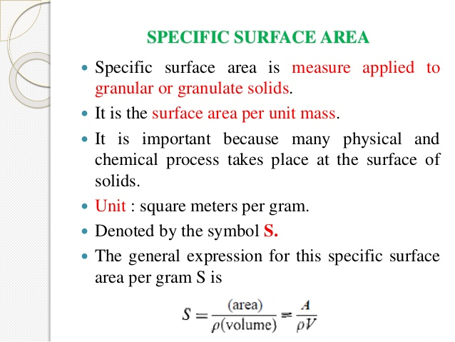

Slide 25
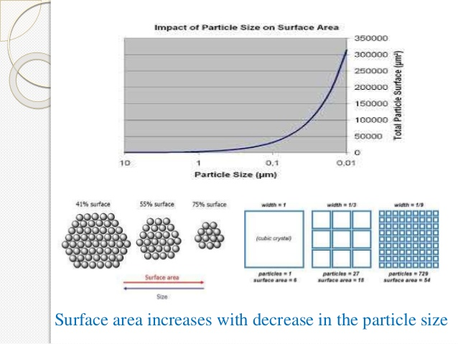

Slide 26
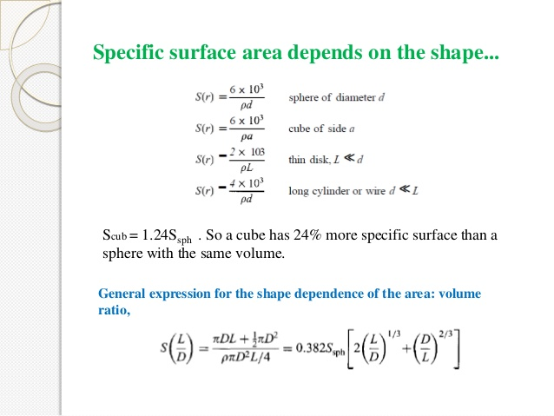

Slide 27
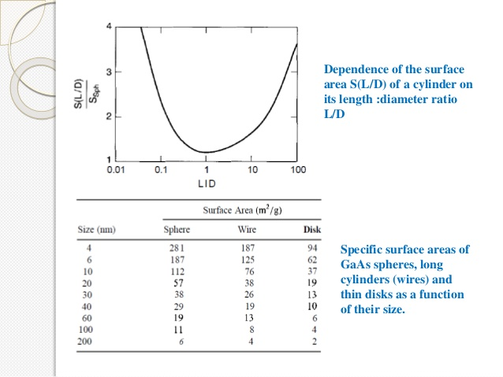

Slide 28
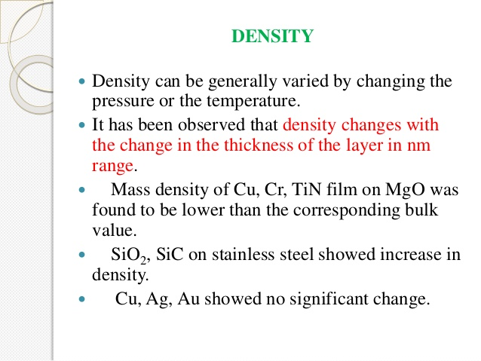

Slide 29
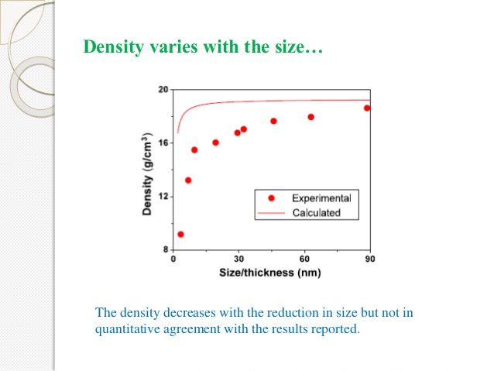

Slide 30
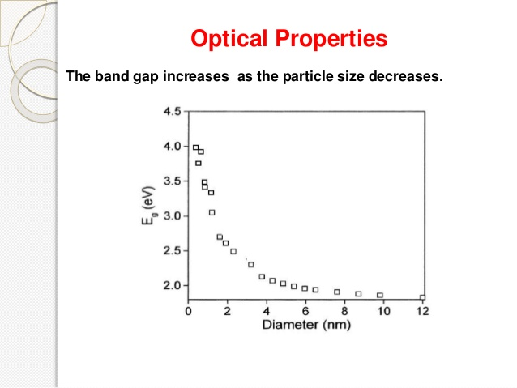

Slide 31
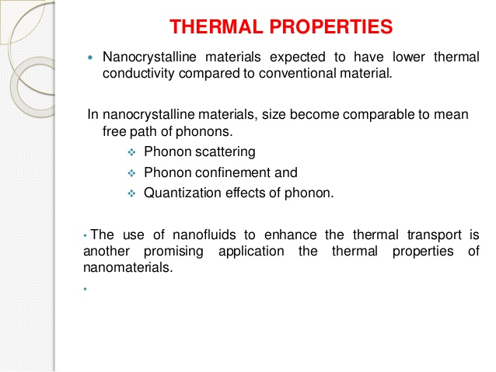

Slide 32
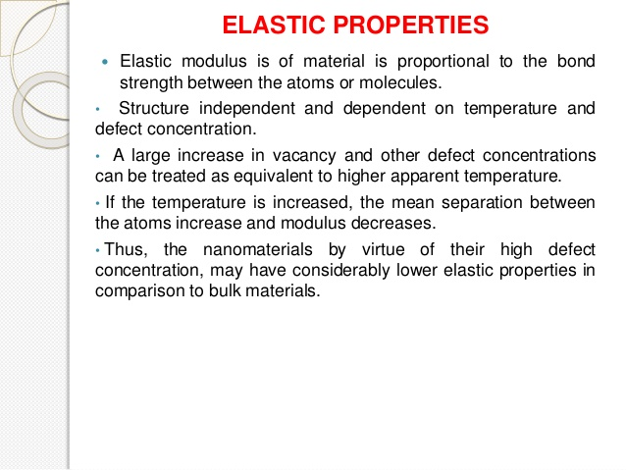

Slide 33
Scale at which Surfaces and Interfaces Play a Large Role in Materials Properties and Interactions
Nanoscale materials have far larger surface areas than similar masses of larger-scale materials.
As surface area per mass of a material increases, a greater amount of the material can come into contact with surrounding materials, thus affecting reactivity.
A simple thought experiment shows why nanoparticles have phenomenally high surface areas.
A solid cube of a material 1 cm on a side has 6 square centimeters of surface area, about equal to one side of half a stick of gum. But if that volume of 1 cubic centimeter were filled with cubes 1 mm on a side, that would be 1,000 millimeter-sized cubes (10 x 10 x 10), each one of which has a surface area of 6 square millimeters, for a total surface area of 60 square centimeters—about the same as one side of two-thirds of a 3” x 5” note card.
When the 1 cubic centimeter is filled with micrometer-sized cubes—a trillion (10¹²) of them, each with a surface area of 6 square micrometers—the total surface area amounts to 6 square meters, or about the area of the main bathroom in an average house.
And when that single cubic centimeter of volume is filled with 1-nanometer-sized cubes—10²¹ of them, each with an area of 6 square nanometers—their total surface area comes to 6,000 square meters.
In other words, a single cubic centimeter of cubic nanoparticles has a total surface area one-third larger than a football field!

Slide 34
